Slide 1

A Project Presentation on AIRLINE RESERVATION SYSTEM
Subject Name: Web Development Project (66654)
Submission Date: 26/1/2019
Department of Computer Technology
Sylhet Polytechnic Institute, Sylhet

Slide 2
AIRLINE RESERVATION SYSTEM
Submitted By
MD OMAR FARUK
Registration no: 228386
Roll: 372689
Group: 5CMT-A2
Supervised By
Shantonu Roy
Dept. of Computer Technology
Sylhet Polytechnic Institute

Slide 3
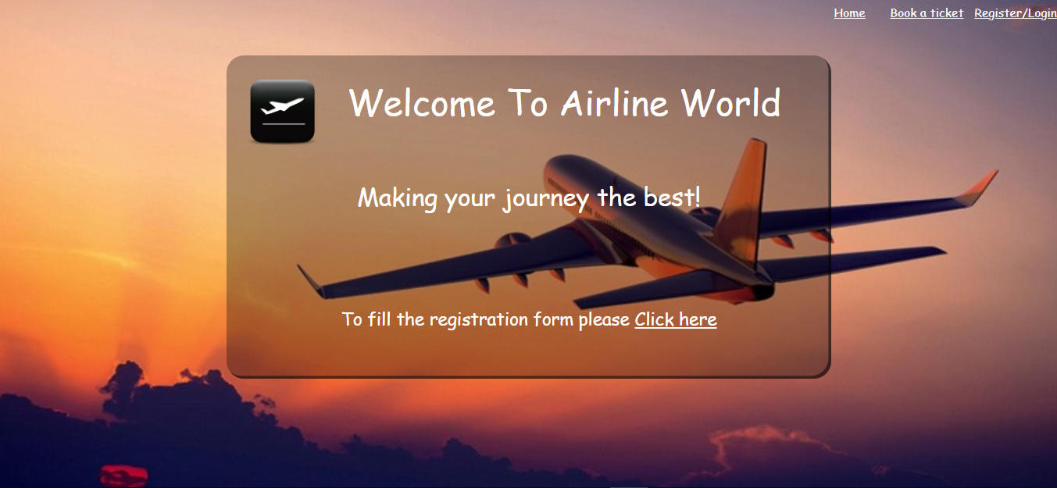

Slide 4
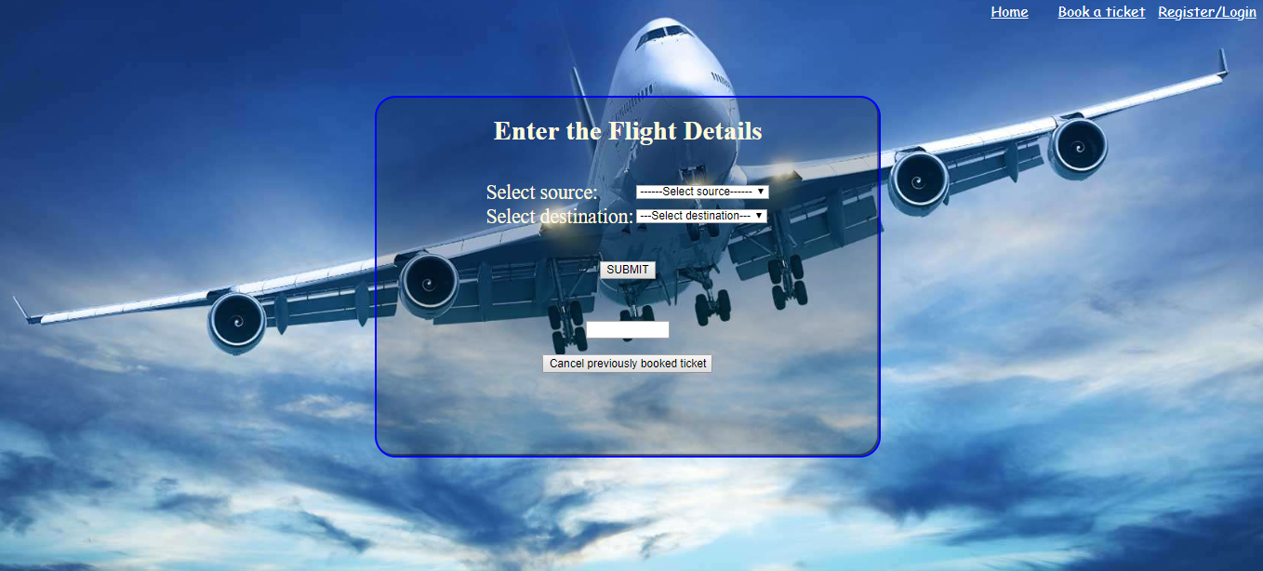

Slide 5
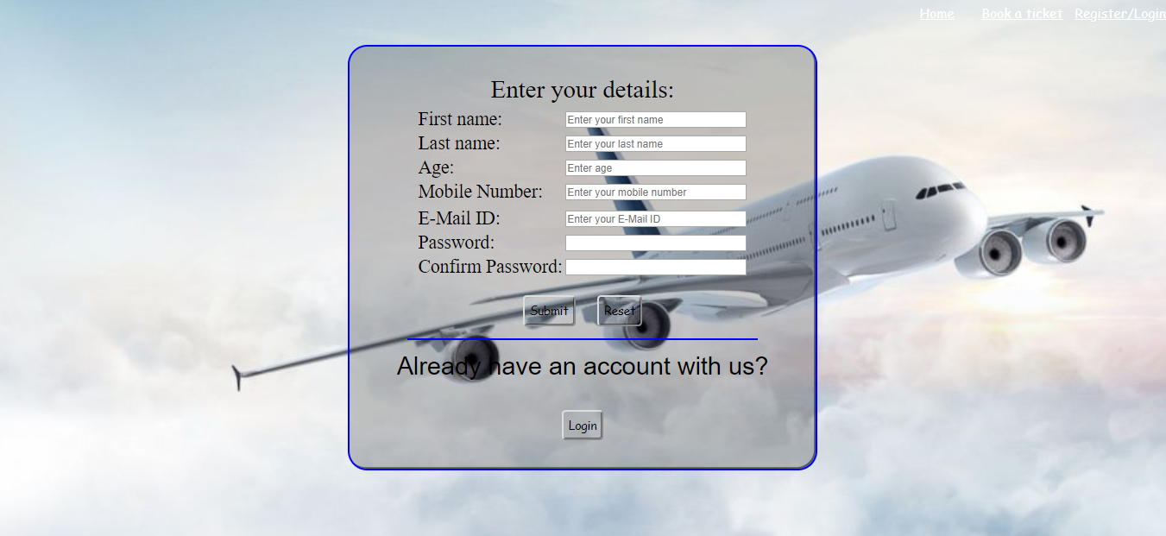

Slide 6
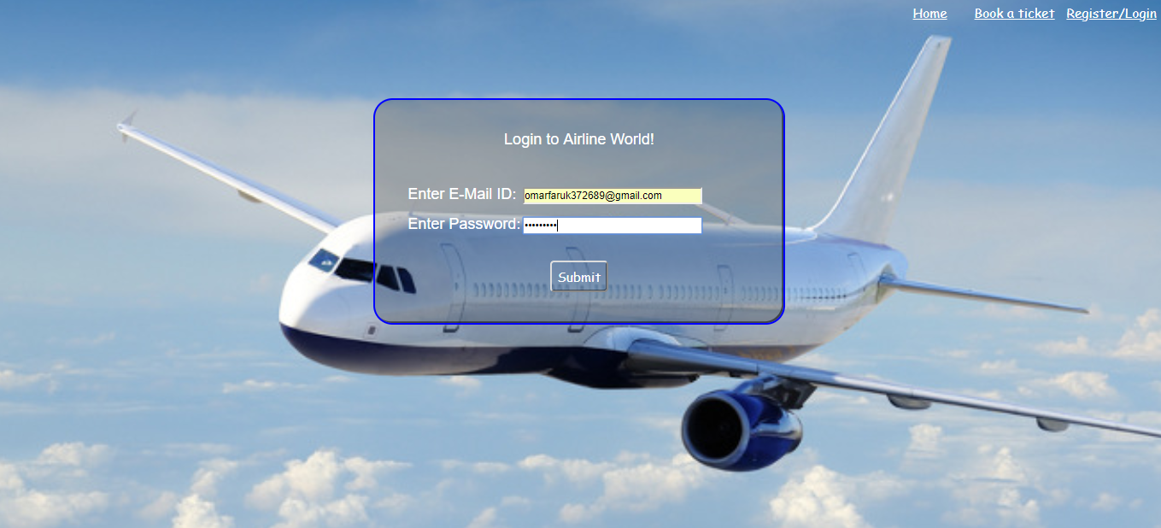

Slide 7
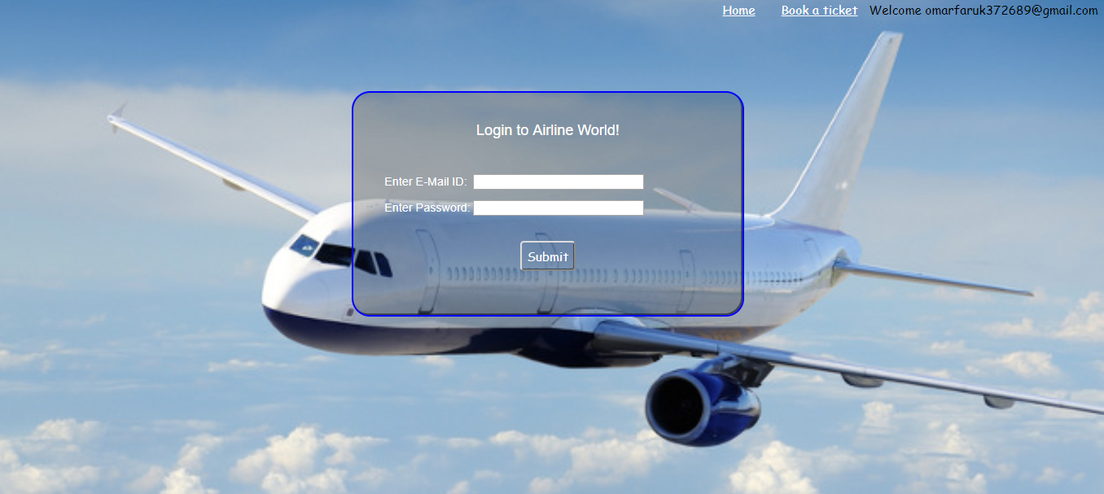

Slide 8
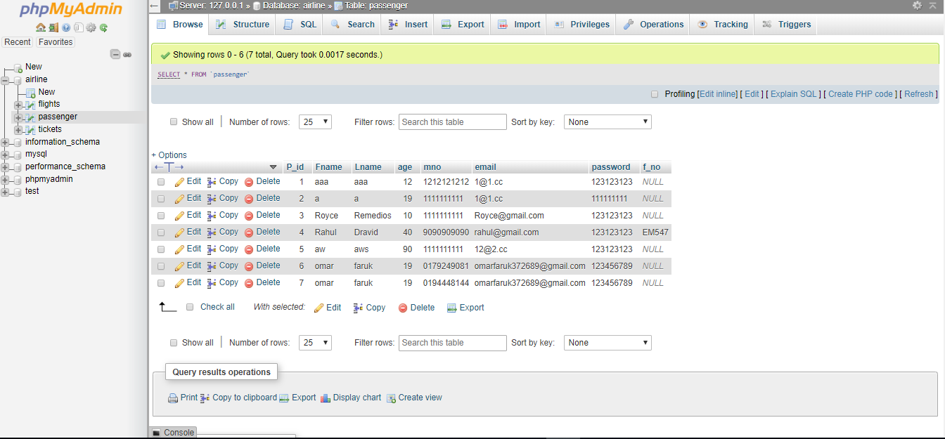
DATABASE AIRLINE

Slide 9
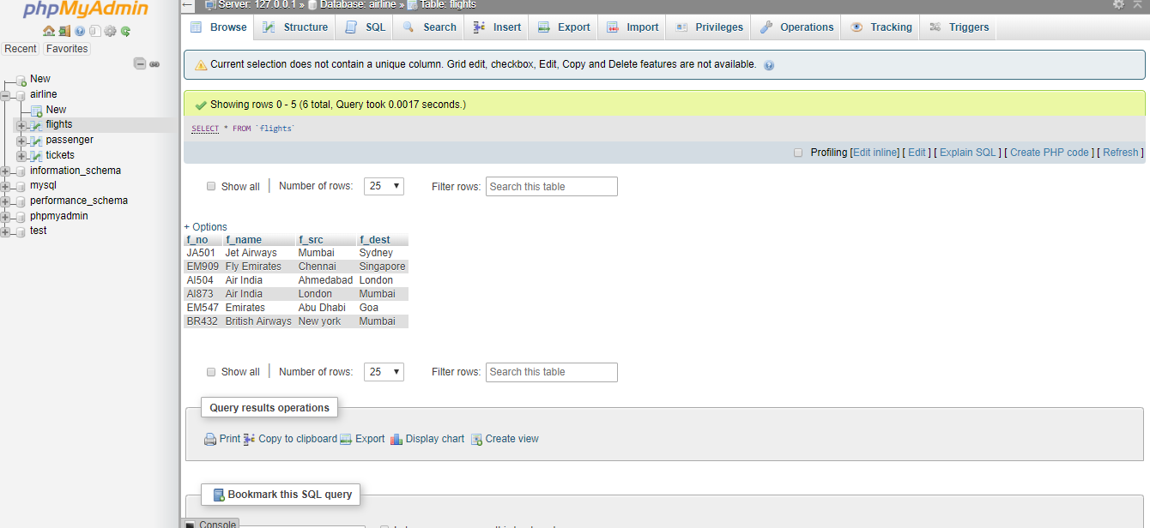

Slide 10
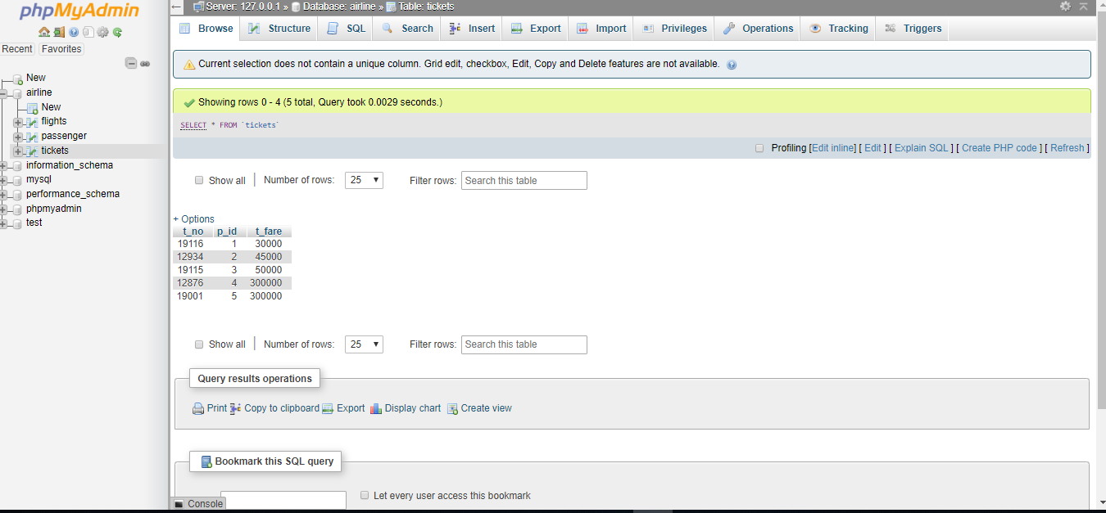

Slide 11
REFERENCES
The following references have been used by me, during all the phases of the MSE project:
http://www.w3schools.com/
Apache J Meter - http://jakarta.apache.org/jmeter/
http://mse.cis.ksu.edu/ - For MSE Project Portfolio.
IEEE Recommended Practice for Software Requirements Specifications - IEEE Std 830- 1998
SLOC Metrics Tool for .NET framework 1.1 http://www.softpedia.com/get/Programming/Other-Programming
. http://www.sitepoint.com/article/sql-server-2000-database - SQL server 2000 help
0. http://www.c-sharpcorner.com/
. http://www.mhhe.com/engcs/compsci/pressman/information/olc/COCOMO.html
. Smart Draw software for the Gantt Chart
. Wikipedia

Slide 12
Acknowledgement
All praises are to the almighty for enabling us to carry out this project. We would like to express our indebtedness and gratitude to our beloved supervisor, Shantonu Roy for his special guidance, valuable suggestions and endless encouragement.
We would also like to thanks our Head of the Department Roksana Nahar, who gave us lots of valuable suggestions and kept pushing us to the limit to get the best out of us. Furthermore, we would also like to acknowledge with much appreciation the crucial role of our beloved teachers and all the faculty members of the School of Science and Engineering for their continuous support.
Finally, we would like to express our indebtedness to our fellow friends and relatives for their cooperation, sacrifice and inspiration during the preparation of this whole project.

Slide 13
THANK YOU FOR WATCH

